Slide 1
Deep Learning Lecture – 3 (Going Deeper)
Sukho Lee(이석호)
Dongseo Univ.
@울산대학교 2018.1.15~16

Slide 2
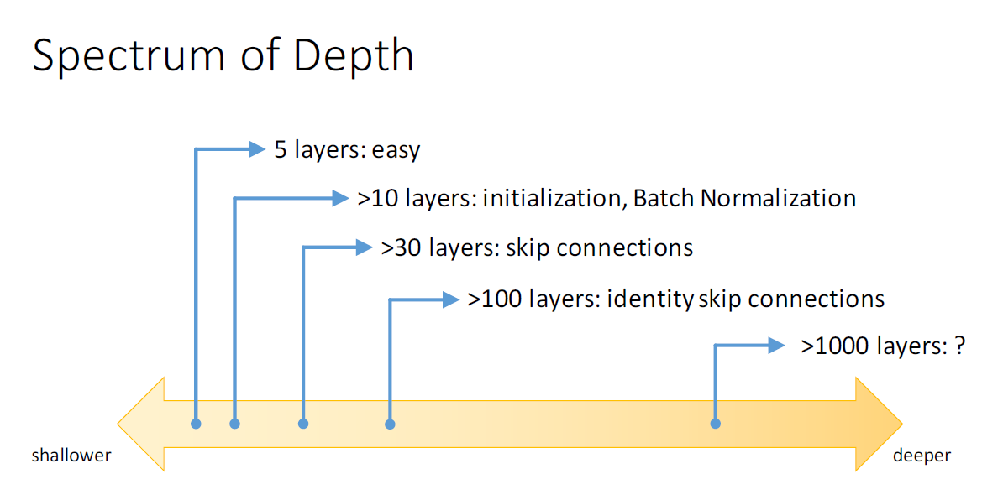
Techniques to overcome deep layers
(Slide Credit goes to Kaiming He)

Slide 3
Batch normalization
= next batch of data
Batch normalization is implemented in Tensorflow by the following functions:
tf.nn.batch_normalization or tf.contrib.layers.batch_norm

Slide 4
Batch normalization
After normalization change the scale and bias to something else.
If standardization is good → the neural network will learn
should be whatever minimizes the cost

Slide 5
When does batch normalization happen?
Regular Layer:
Layer with Batch-Norm:
Batch normalization

Slide 6
During test time
: Collected during training

Slide 7
Inception Model
(by Google)
Paper: Going Deeper with Convolutions
(https://arxiv.org/abs/1409.4842)
Explanations : https://hacktilldawn.com/2016/09/25/inception-modules-explained-and-implemented/
Code : https://github.com/tmulc18/Inception

Slide 8
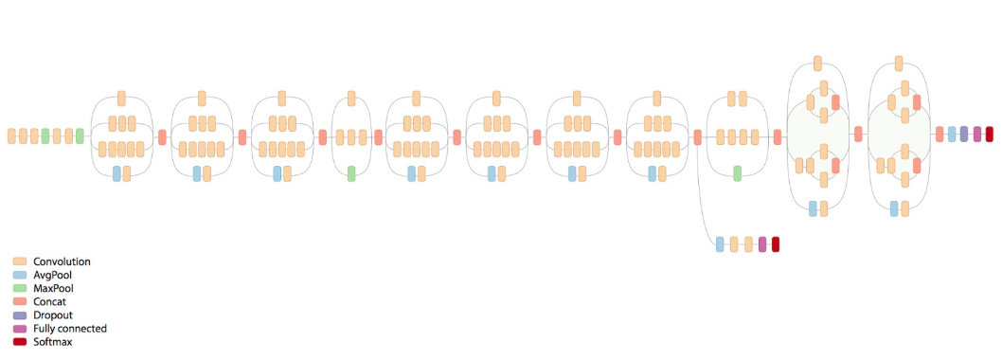
Inception V3
Inception Modules
Inception v3 is a repetition of Inception modules
https://www.youtube.com/watch?v=QfNvhPx5Px8

Slide 9
Inception V3
By retraining the last two layers you can make your own image classifier
https://www.youtube.com/watch?v=QfNvhPx5Px8

Slide 10
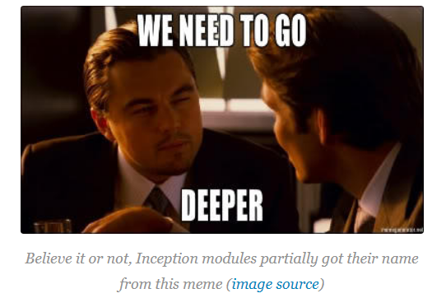
Inception V3

Slide 11
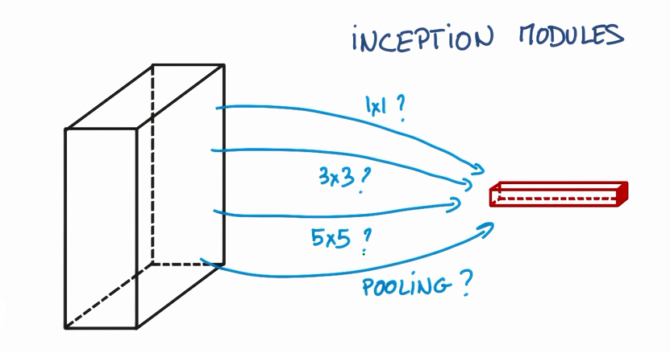
Inception Modules
The inspiration comes from the idea that you need to make a decision as to what type of convolution you want to make at each layer: Do you want a 3×3? Or a 5×5? And this can go on for a while.
→ So why not use all of them and let the model decide?

Slide 12
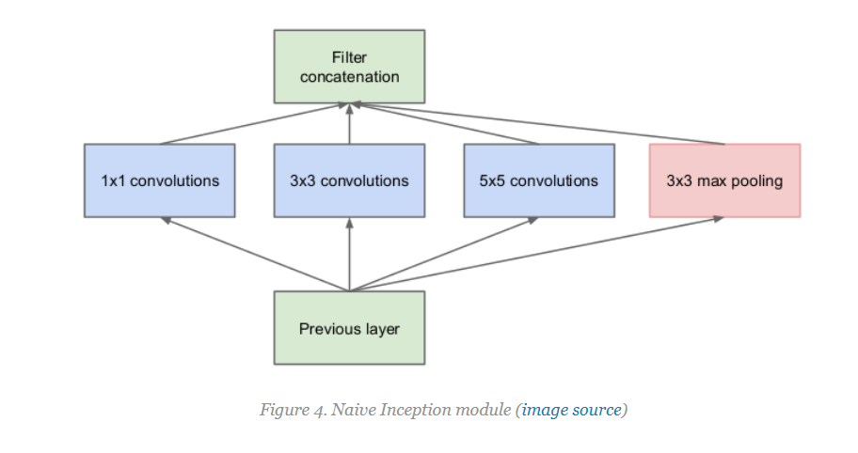
Naïve Inception Module
What’s the problem with this module?

Slide 13
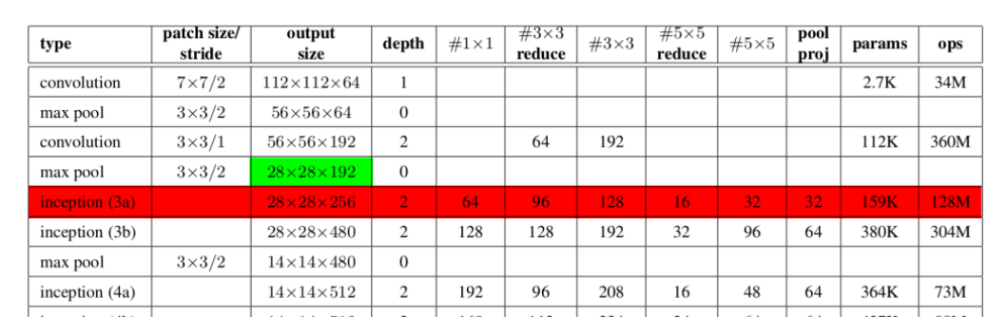
Naïve Inception Module
Input channel : 192
Output channel of mere 5x5
: 32

Slide 14
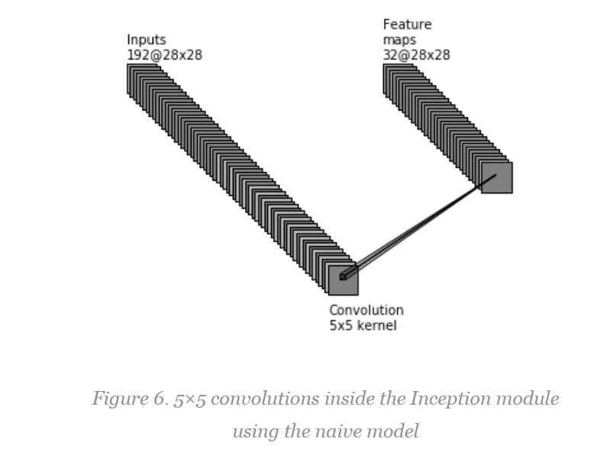
Naïve Inception Module
Number of operations:

Slide 15
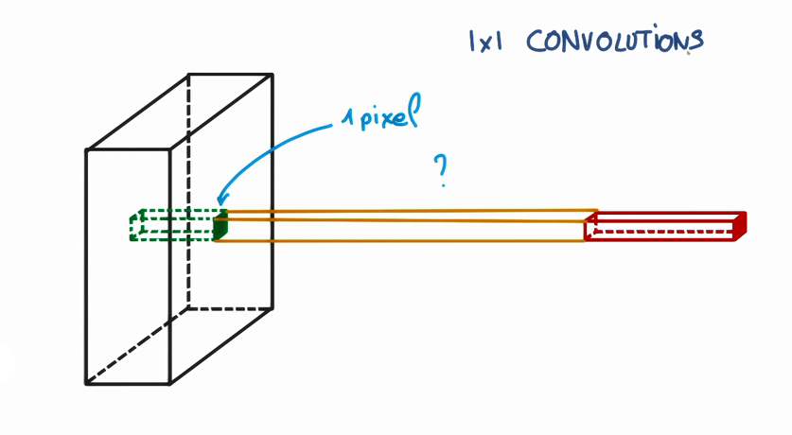
1x1 Convolution

Slide 16
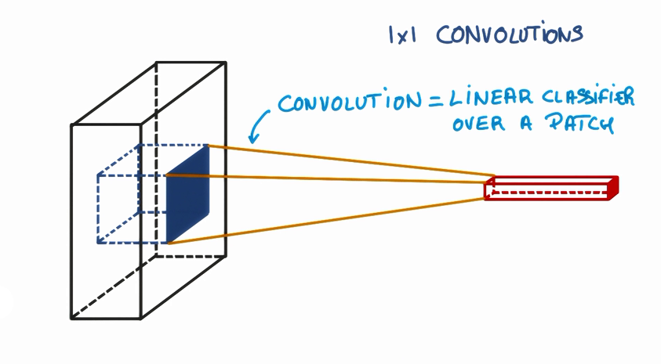
1x1 Convolution
This is only a linear Classifier of the network

Slide 17
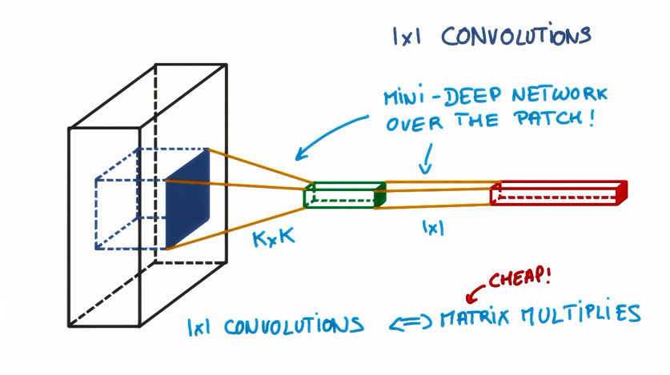
1x1 Convolution
1x1 Convolution introduce non-linearity(with ReLU) and Dimension change
From Linear Classifier to Mini-Deep Networks

Slide 18
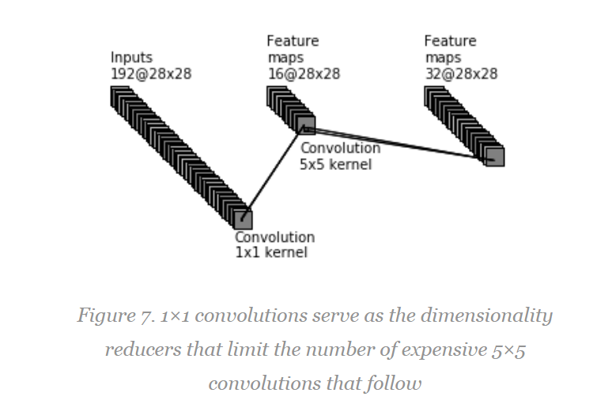
1x1 Convolution
1/10만큼 줄었다.
Number of operations:

Slide 19
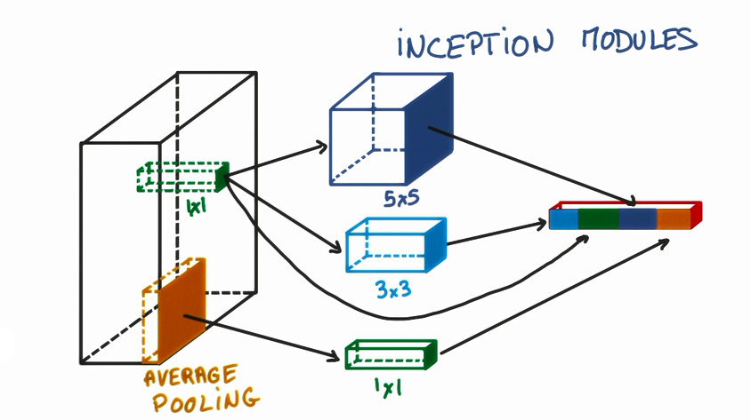
Inception Module with 1x1 Convolution

Slide 20
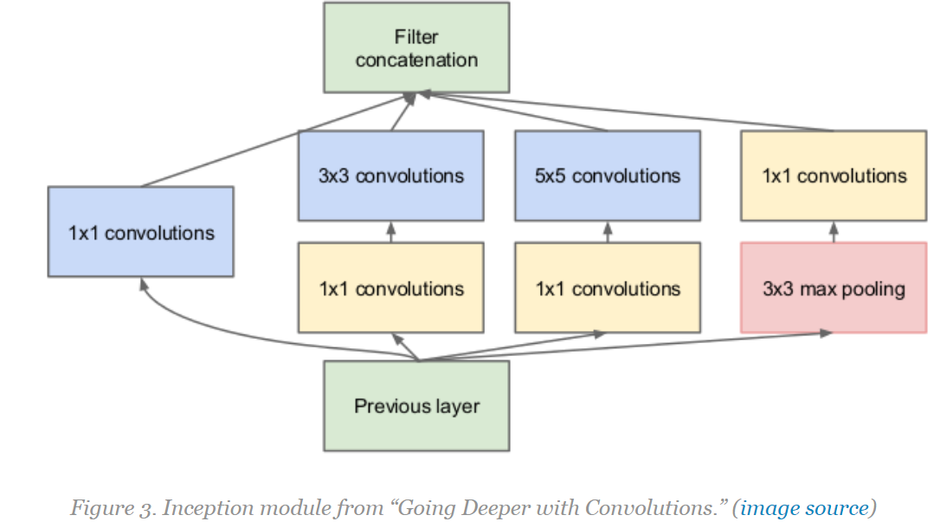
Inception Module with 1x1 Convolution

Slide 21
Residual Neural Network (ResNet)
(Keiming He et al.)

Slide 22
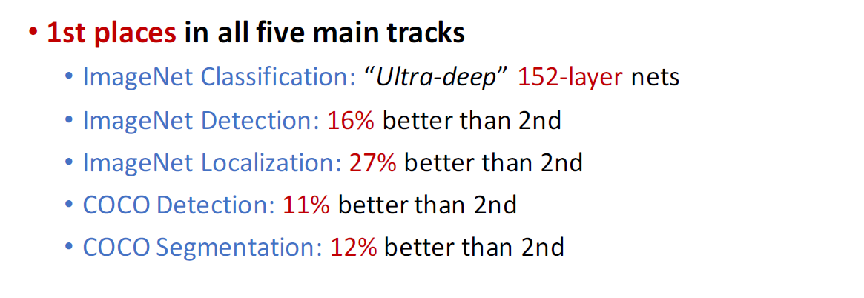
ILSVRC & COCO 2015 Competition Results
(Slide Credit goes to Kaiming He)

Slide 23
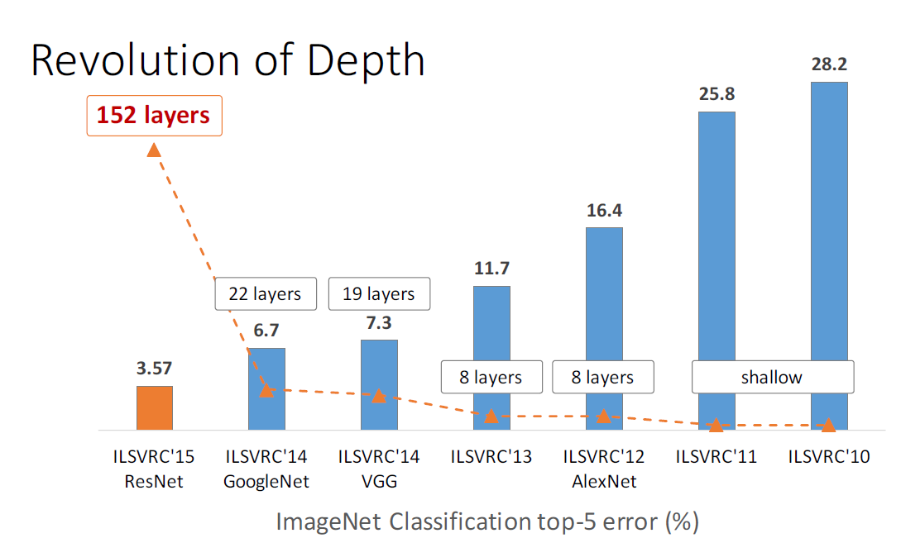
Depth
(Slide Credit goes to Kaiming He)

Slide 24
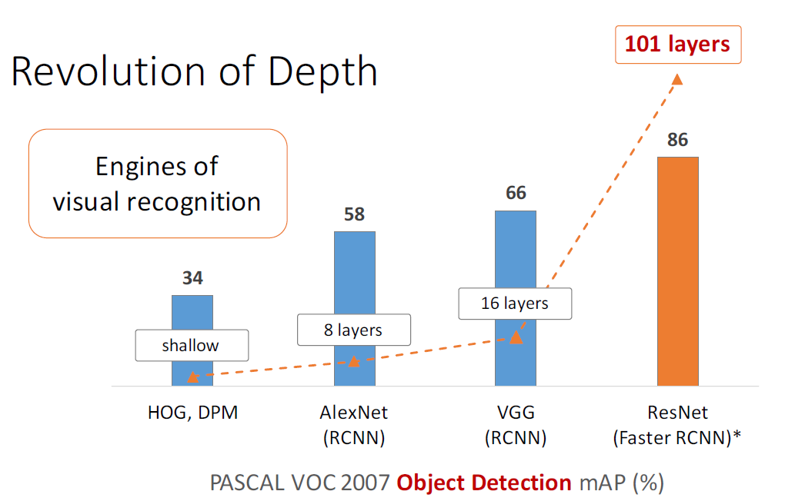
Depth
(Slide Credit goes to Kaiming He)

Slide 25
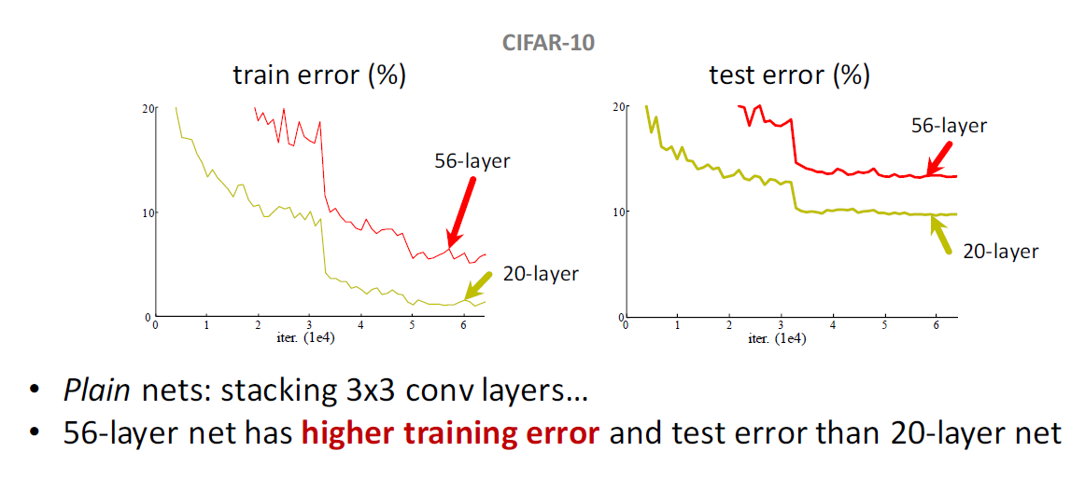
Result of Simply Stacking Layers
(Slide Credit goes to Kaiming He)

Slide 26
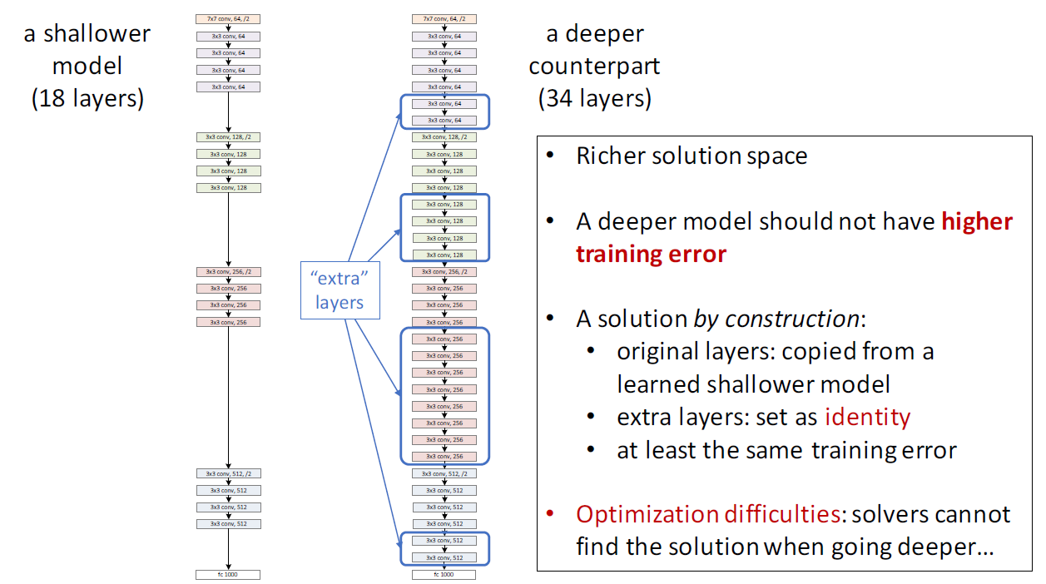
ResNet:
Why deeper networks should work better
(Slide Credit goes to Kaiming He)

Slide 27
Why Standard Convolutional Networks are hard to train
State 1
conv
State 2
conv
State 3
convolution changes the state, but also passes on information that
needs to be preserved.
There is redundant (too much) information flowing through
the convolutions.
The role of the conv is too much. (We have to find a filter which can
Preserve AND also catch new information)
ensure maximum information flow between layers in the network

Slide 28
Why Standard Convolutional Networks are hard to train
The approximation of the gradient becomes inaccurate when the
non-linearity of the function expressed by the network becomes higher
The effective path of the gradient flow should be shorter.
(Deep supervision, Stochastic Drop-path, Skip-layer,……..)
The gradient flow should flow through not so non-linear function

Slide 29
Why Standard Convolutional Networks are hard to train
Information of State 1 is passed to State 2 (without the use of parameters)
State 1
conv
State 2
conv
State 3
+
Convolution only passed information that is changed

Slide 30
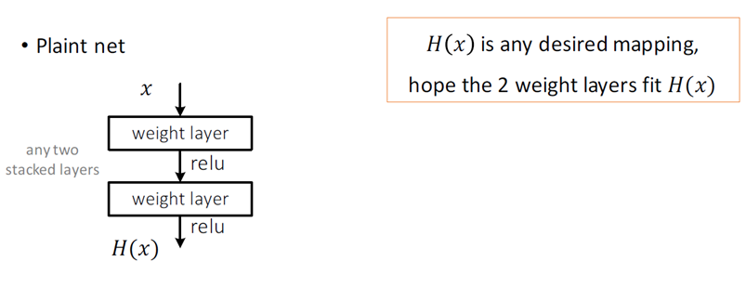
Block of Plain Net
(Slide Credit goes to Kaiming He)

Slide 31
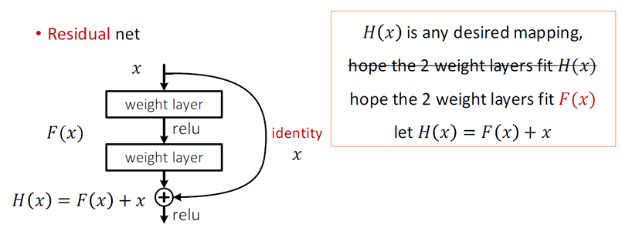
Block of ResNet
(Slide Credit goes to Kaiming He)

Slide 32
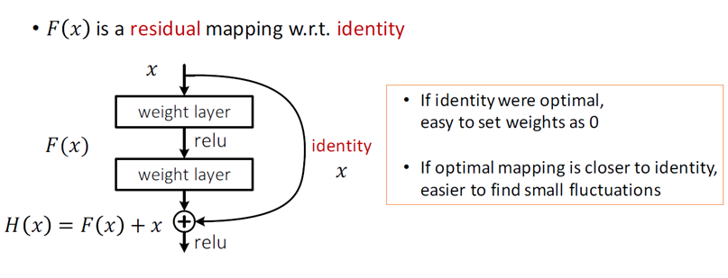
Block of ResNet
Instead of
we learn the residual
(Slide Credit goes to Kaiming He)

Slide 33
Function represented by ResNet
weight layer
weight layer
weight layer
For similar complexity of H(x), F₁(x),… may
become more linear when the number of
layers increase.
weight layer
weight layer
weight layer

Slide 34
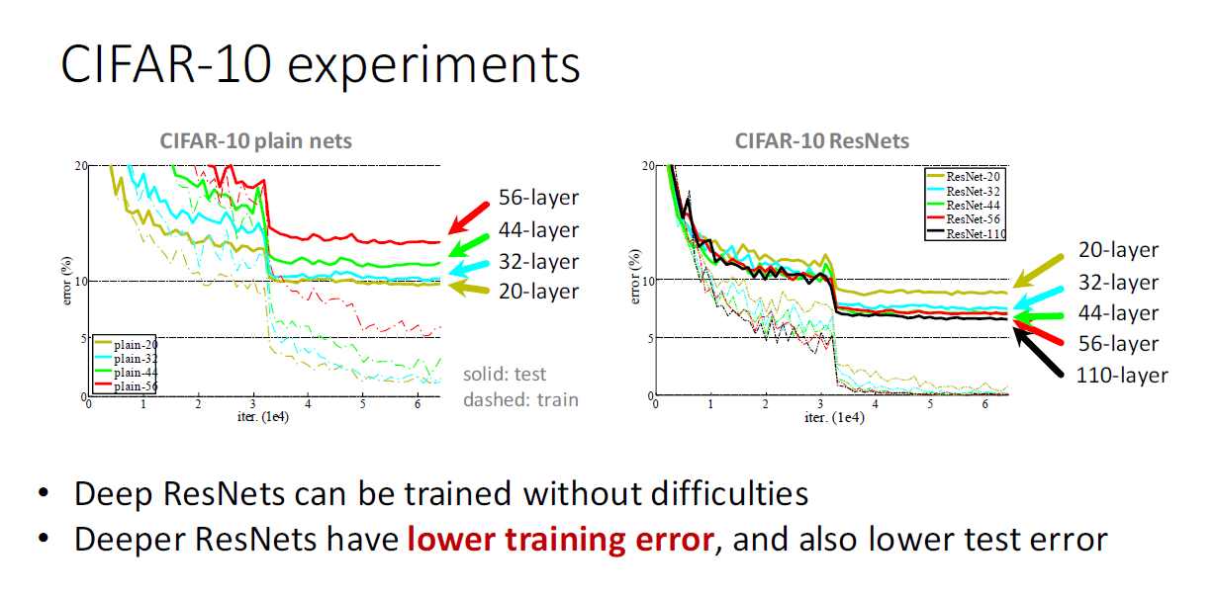
Experiments
(Slide Credit goes to Kaiming He)

Slide 35
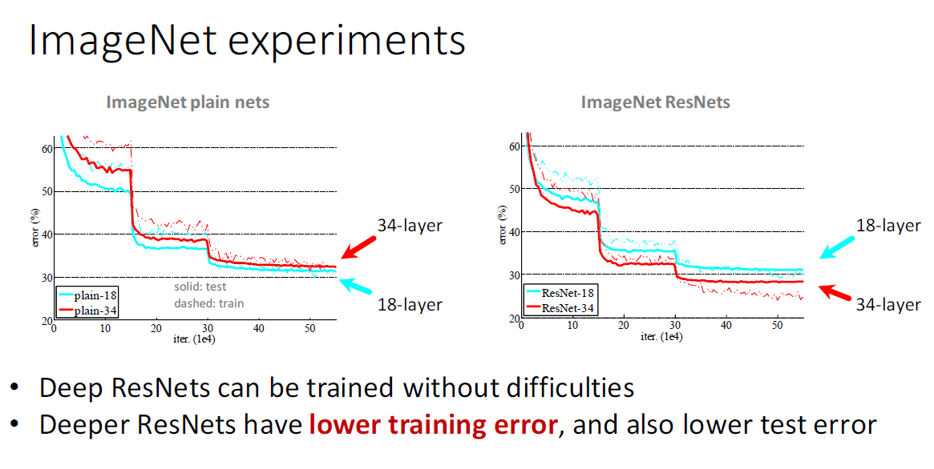
Experiments
(Slide Credit goes to Kaiming He)

Slide 36
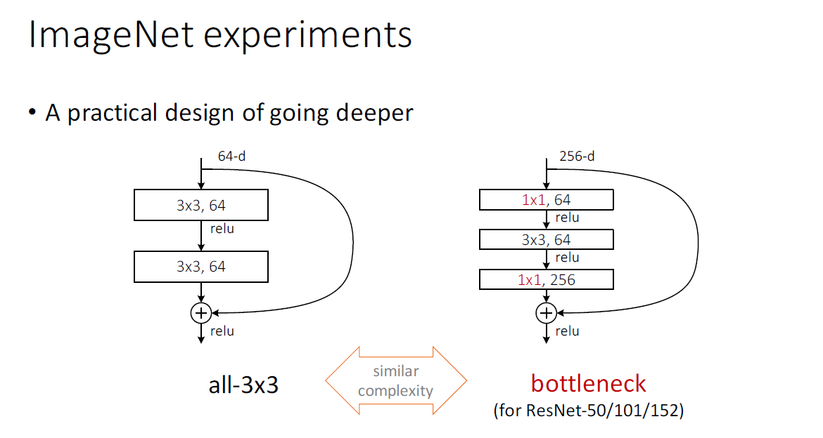
Experiments
(Slide Credit goes to Kaiming He)

Slide 37
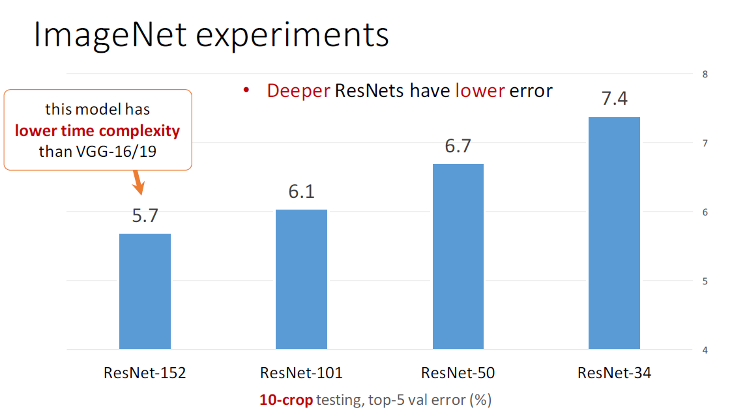
Experiments
(Slide Credit goes to Kaiming He)

Slide 38
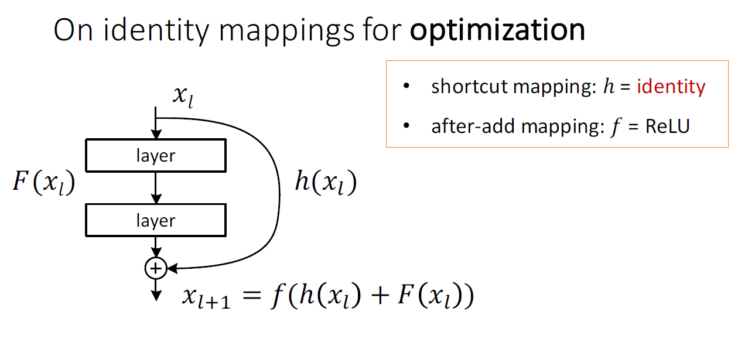
Importance of Identity Mapping
(from 100 to 1000 layers)
(Slide Credit goes to Kaiming He)

Slide 39
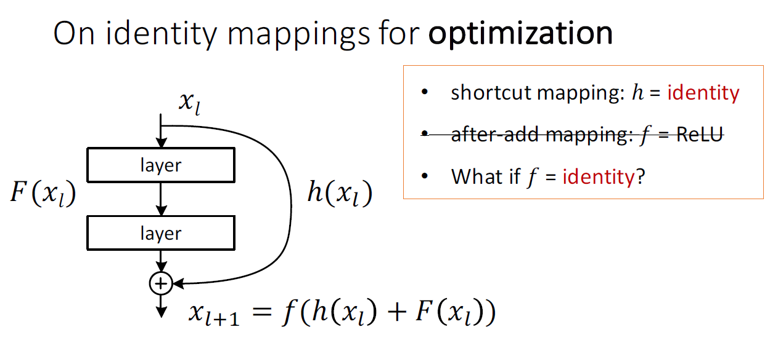
Importance of Identity Mapping
(from 100 to 1000 layers)
(Slide Credit goes to Kaiming He)

Slide 40
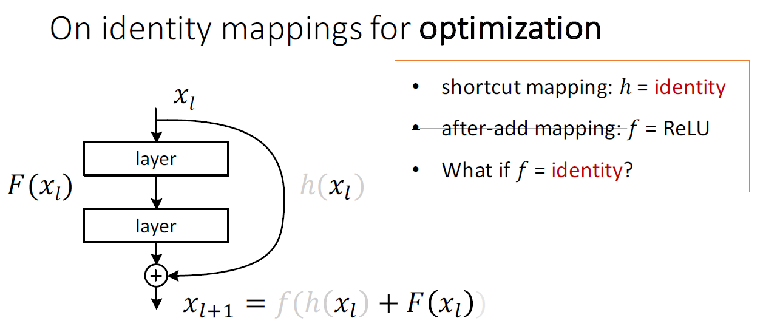
Importance of Identity Mapping
(from 100 to 1000 layers)
(Slide Credit goes to Kaiming He)

Slide 41
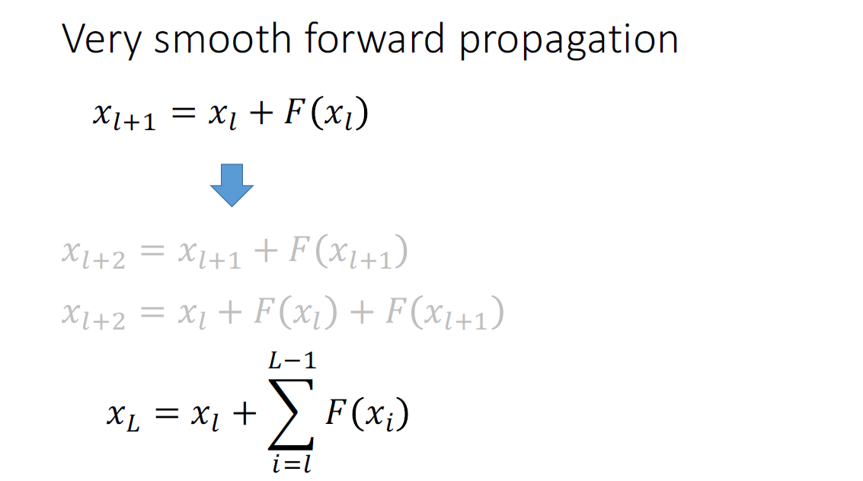
Smooth Forward Propagation
(Slide Credit goes to Kaiming He)

Slide 42
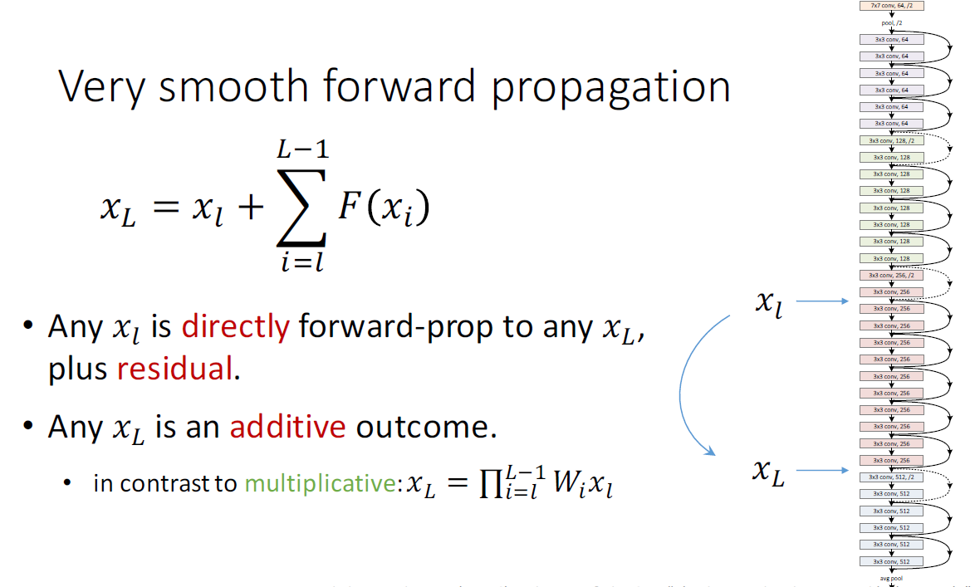
Smooth Forward Propagation
(Slide Credit goes to Kaiming He)

Slide 43
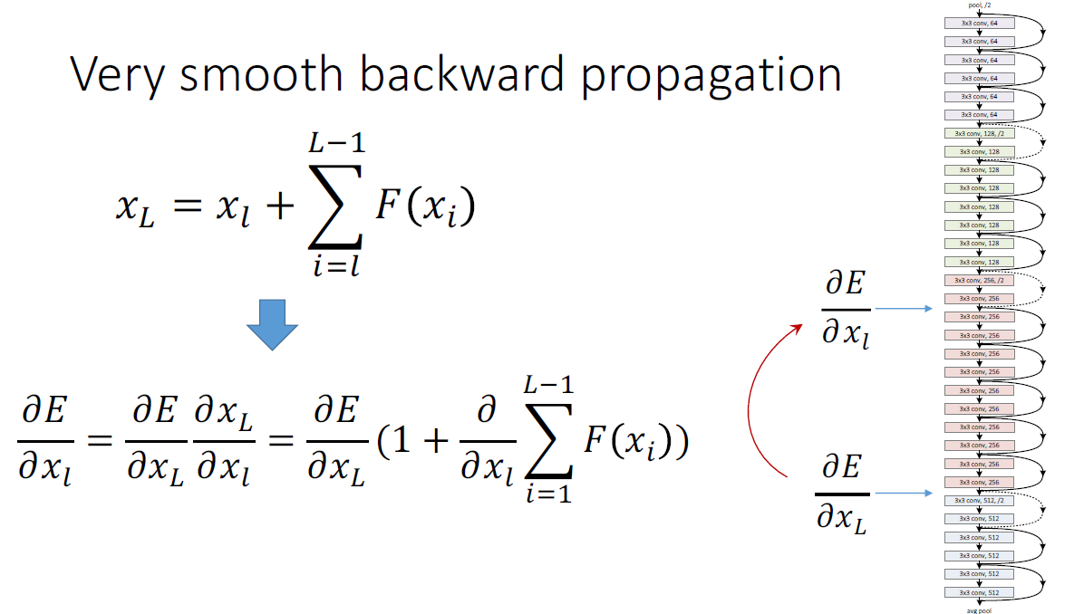
Smooth Backward Propagation
(Slide Credit goes to Kaiming He)

Slide 44
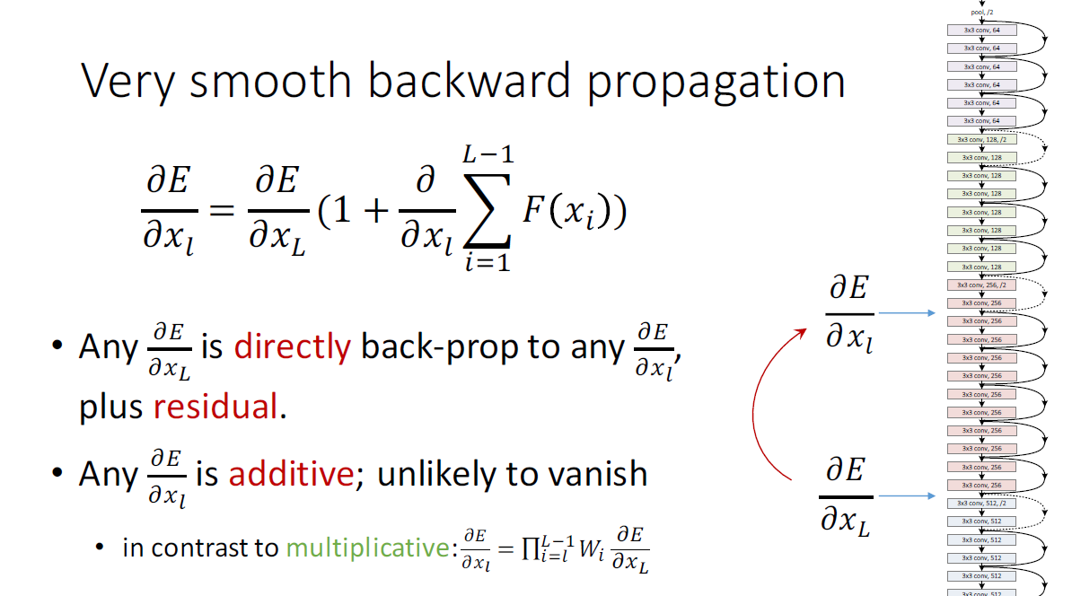
Smooth Backward Propagation
(Slide Credit goes to Kaiming He)

Slide 45
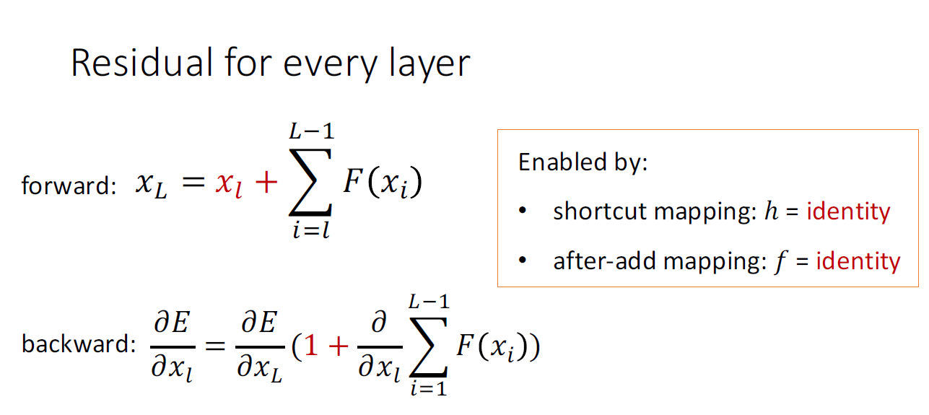
Smooth Backward Propagation
(Slide Credit goes to Kaiming He)

Slide 46
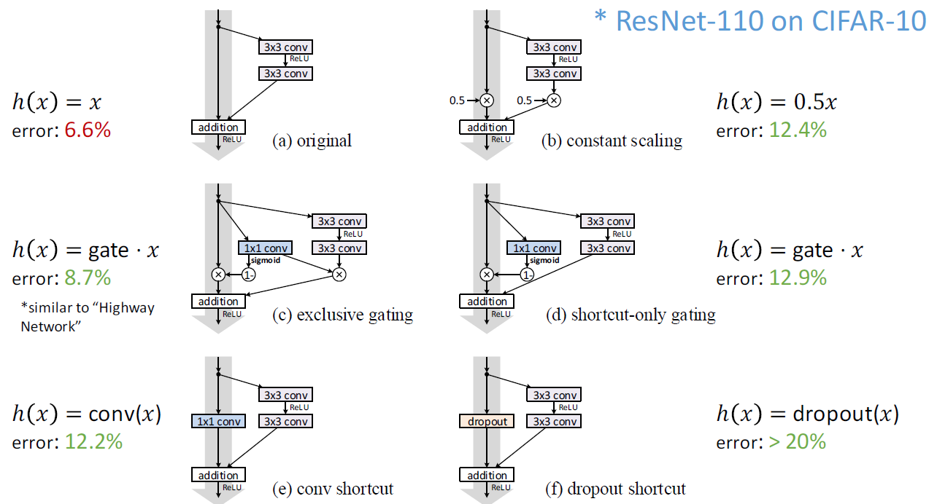
Experiment1 : What if shortcut mapping h is not identity
(Slide Credit goes to Kaiming He)

Slide 47
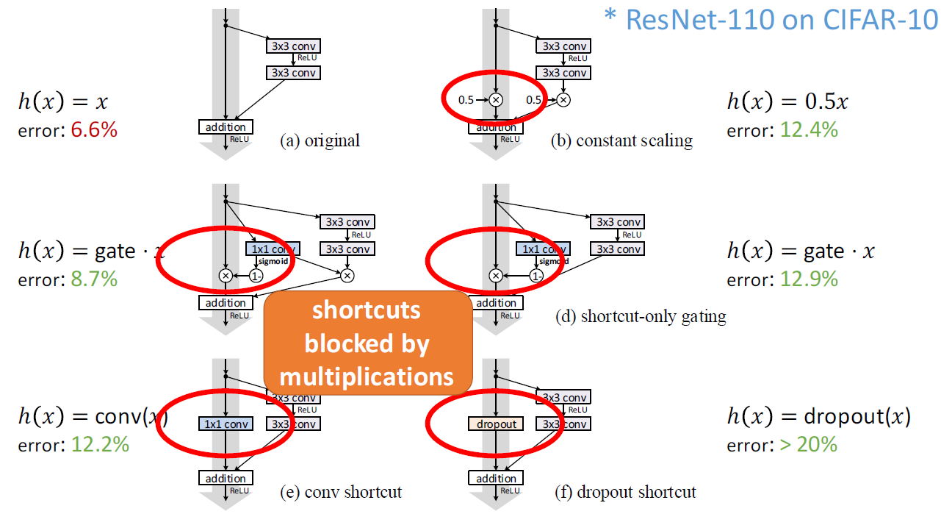
Experiment1 : What if shortcut mapping h is not identity
(Slide Credit goes to Kaiming He)

Slide 48
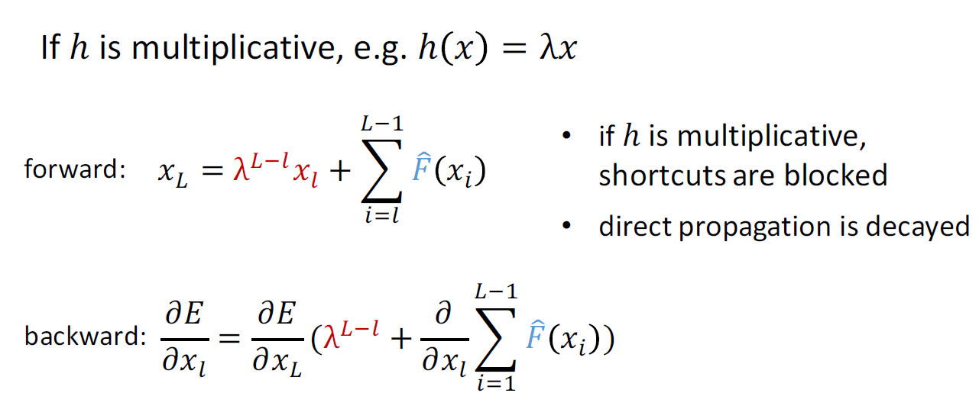
Experiment1 : What if shortcut mapping h is not identity
(Slide Credit goes to Kaiming He)

Slide 49
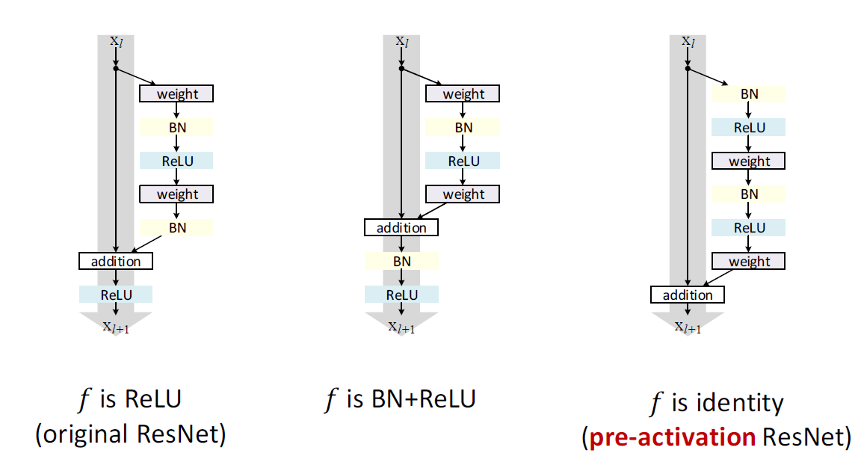
Experiment2 : What if after-add mapping f is identity
(Slide Credit goes to Kaiming He)

Slide 50
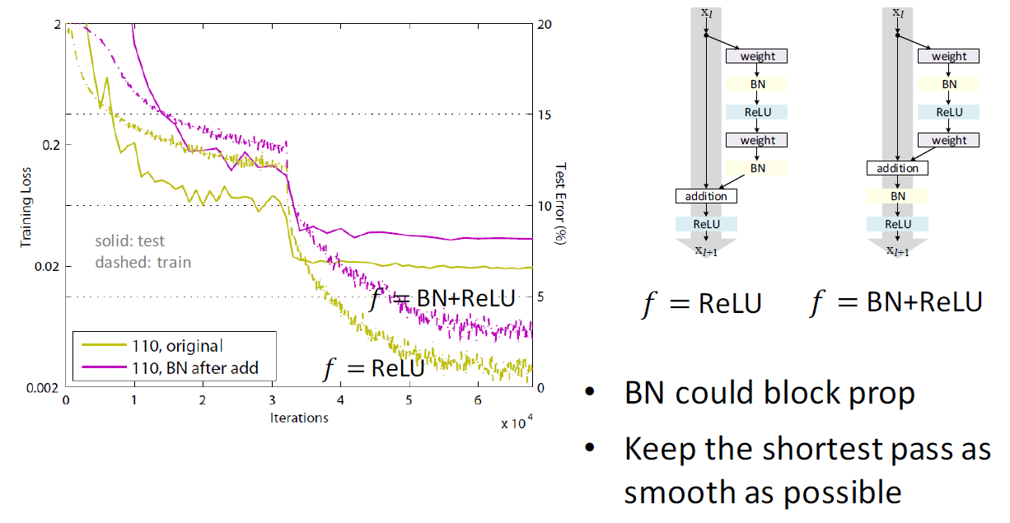
Experiment2 : What if after-add mapping f is identity
(Slide Credit goes to Kaiming He)

Slide 51
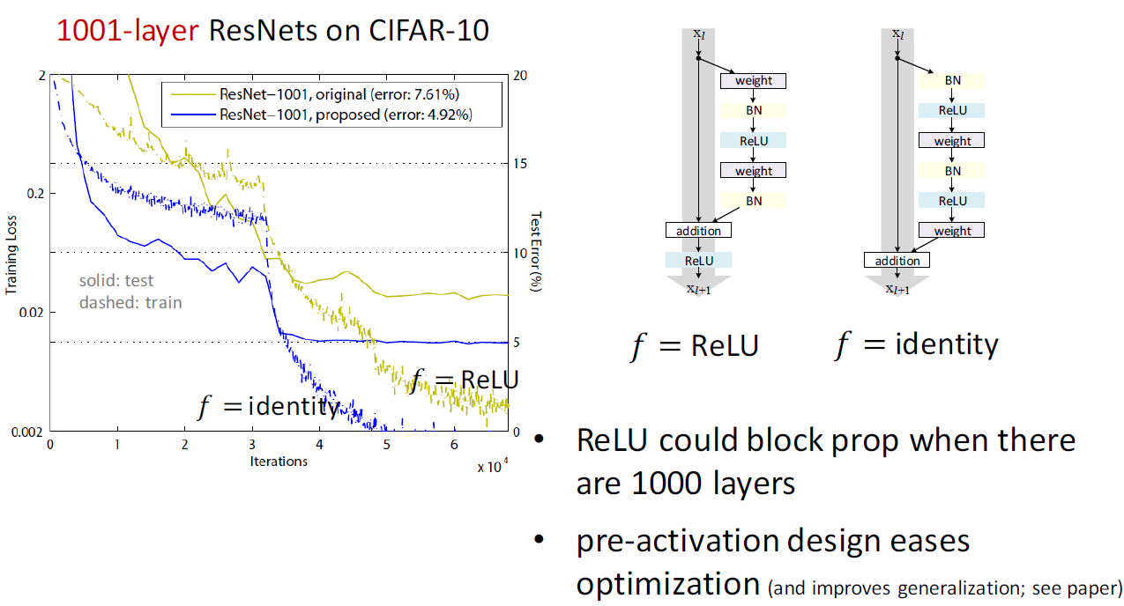
Experiment2 : What if after-add mapping f is identity
(Slide Credit goes to Kaiming He)

Slide 52
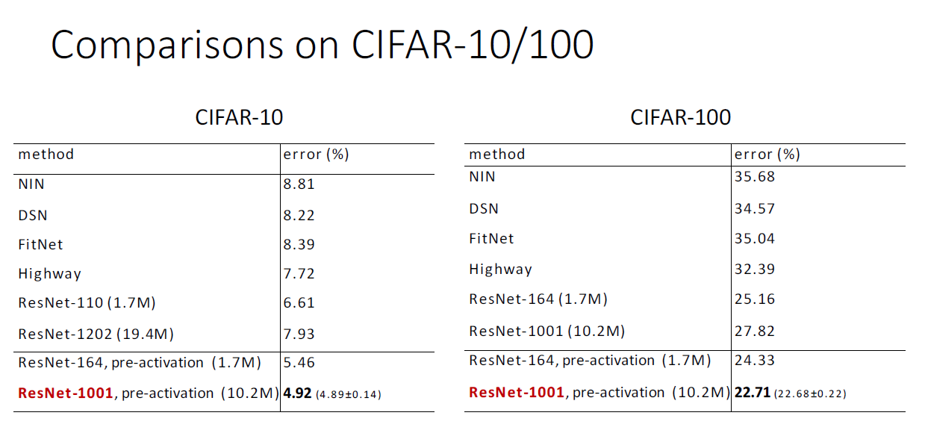
ResNet with pre-activation
(Slide Credit goes to Kaiming He)

Slide 53
Tensorflow Practice6 : Residual Neural Network
https://github.com/ry/tensorflow-resnet

Slide 54
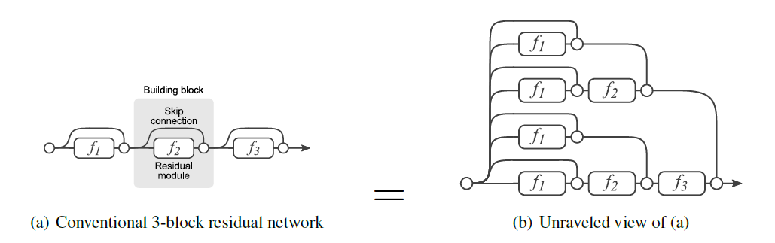
Residual Networks behave like Ensembles of
Relatively Shallow Networks
There exist several paths, of which some are relatively short.
It is shown that most of the information flow through the short paths.

Slide 55
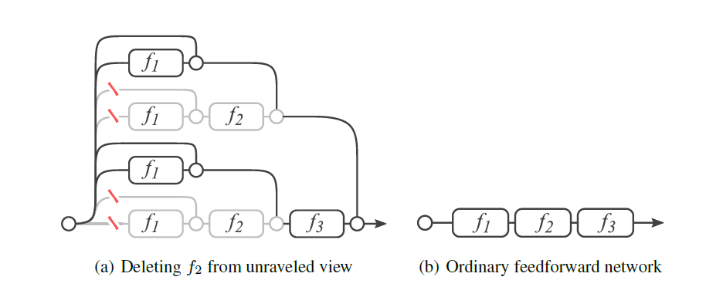
Residual Networks behave like Ensembles of
Relatively Shallow Networks
Effect of deleting a certain filter in ResNet.

Slide 56
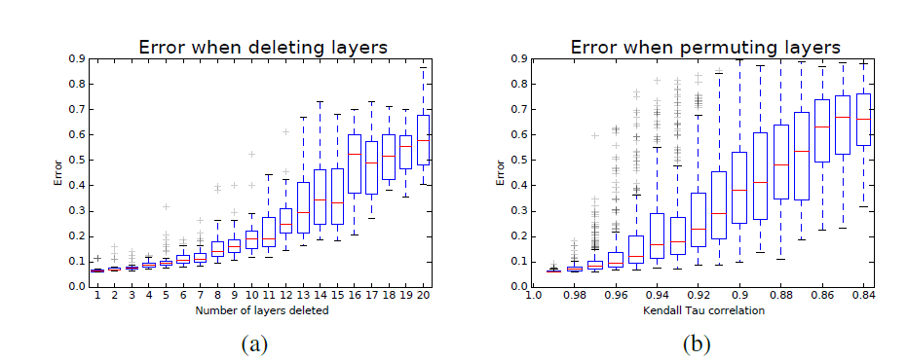
Residual Networks behave like Ensembles of
Relatively Shallow Networks
Increasing the number of deleting layers will introduce error which grows
smoothly → Same effect as can be expected in ensembles.

Slide 57
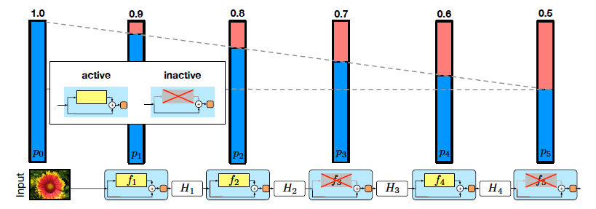
Deep Networks with Stochastic Depth (drop path)
Idea: make shorter paths during training.
→ delete filters stochastically during training
Linear decay in the survival probability of different layers

Slide 58
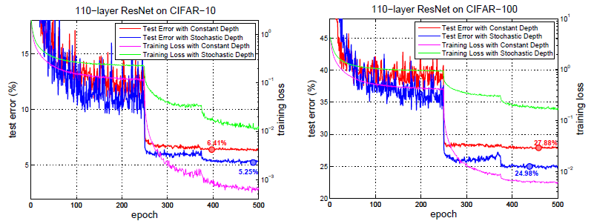
Deep Networks with Stochastic Depth (drop path)

Slide 59
Densely Connected Neural Network
(DenseNet)

Slide 60
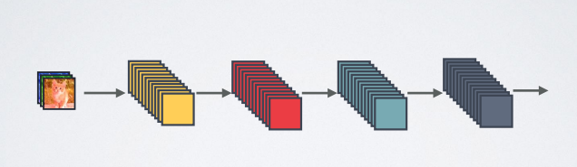
DenseNet:
Structure of Standard Networks
(Slide Credit goes to Gao Huang)

Slide 61
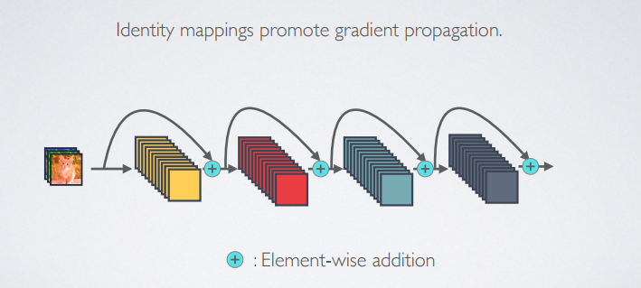
DenseNet:
Structure of Residual Networks
(Slide Credit goes to Gao Huang)

Slide 62
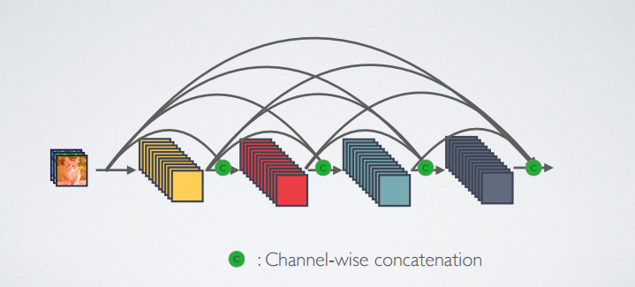
DenseNet:
Structure of Dense Networks
(Slide Credit goes to Gao Huang)

Slide 63
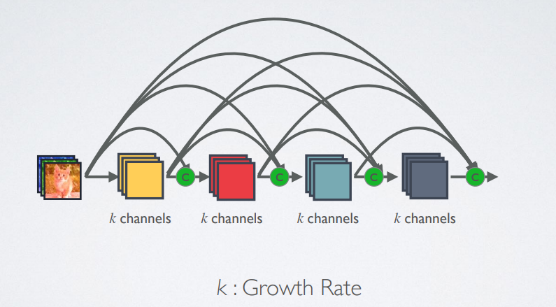
Slim Channels with Dense Networks
(Slide Credit goes to Gao Huang)

Slide 64
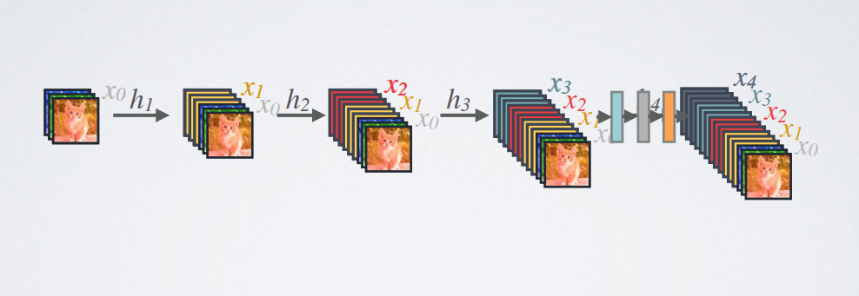

Forward Propagation
(Slide Credit goes to Gao Huang)

Slide 65

Advantage1 : Strong gradient flow
(Slide Credit goes to Gao Huang)

Slide 66

Advantage2 : Parameter & Computational Efficiency
(Slide Credit goes to Gao Huang)

Slide 67

Advantage3 : Maintain low complexity features
(Slide Credit goes to Gao Huang)

Slide 68

Advantage3 : Maintain low complexity features
(Slide Credit goes to Gao Huang)

Slide 69

Results
(Slide Credit goes to Gao Huang)

Slide 70

Results
(Slide Credit goes to Gao Huang)

